Slide 1
Microprocessor(CSE-221)
Topic:
Interfacing with Keypad Display
Submitted to: Prof. Rajesh Kr
Team Members
Jagmohan Singh 13BCE1056
M.Akhil Reddy 13BCE1078
VIT CHENNAI

Slide 2
Abstract
The microprocessor is a multipurpose, programmable device that accepts digital data as input, processes it according to instructions stored in its memory, and provides results as output. It is an example of sequential digital logic, as it has internal memory.

Slide 3
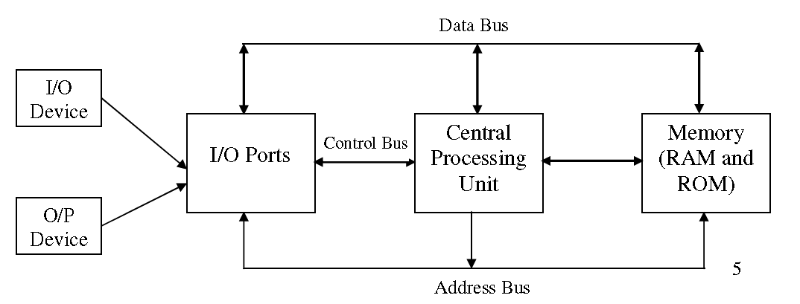
Simple Micro-Computer

Slide 4
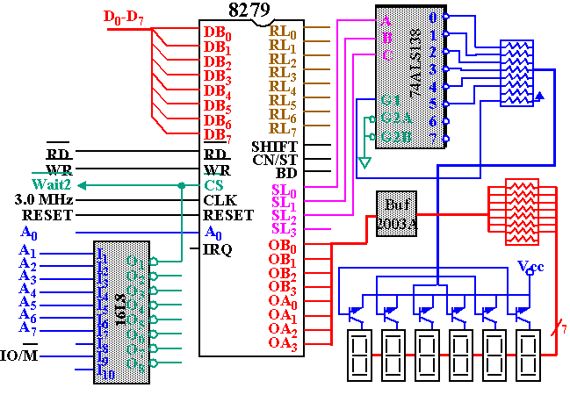

Slide 5
Programmable Keyboard/Display Interface - 8279
A programmable keyboard and display interfacing chip.
Scans and encodes up to a 64-key keyboard.
Controls up to a 16-digit numerical display.
Keyboard has a built-in FIFO 8 character buffer.
The display is controlled from an internal 16x8 RAM that stores the coded display information.

Slide 6
Procedure
Check 1 : Whether any key is pressed or not?
1. Make all column lines zero by sending low on all output lines. This activates all keys in the keyboard matrix. (Note: When scan lines are logic high, the status on the return
lines do not charge, it will remain logic high).
2. Read the status of return lines. If the status of all lines is logic high, key is not pressed; otherwise key is pressed.
Check 2 :
Activate keys from any one column by making any one column line zero.
Read the status of return lines. The zero on any return line indicates key is pressed from the corresponding row and selected column. If the status of all lines is logic high, key is
not pressed from that column.
Activate the keys from the next column and repeat 2 and 3 for all columns.

Slide 7
Pinout Definition 8279
A0: Selects data (0) or control/status (1) for reads and writes between micro and 8279.
BD: Output that blanks the displays.
CLK: Used internally for timing. Max is 3 MHz's
CN/ST: Control/strobe, connected to the control key on the keyboard.
CS: Chip select that enables programming, reading the keyboard, etc.
DB7-DB0: Consists of bidirectional pins that connect to data bus on micro.
IRQ: Interrupt request, becomes 1 when a key is pressed, data is available.
OUT A3-A0/B3-B0: Outputs that sends data to the most significant/least significant nibble of display.
RD(WR): Connects to micro's IORC or RD signal, reads data/status registers.
RESET: Connects to system RESET.
RL7-RL0: Return lines are inputs used to sense key depression in the keyboard matrix.
Shift: Shift connects to Shift key on keyboard.
SL3-SL0: Scan line outputs scan both the keyboard and displays

Slide 8
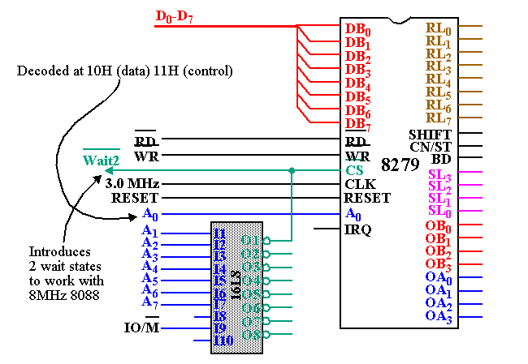
8279 Interfaced to the 8088(8086)

Slide 9
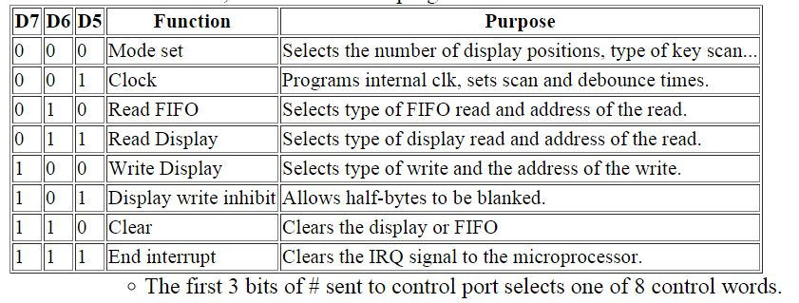
Keyboard Interface of 8279
The keyboard matrix can be any size from 2x2 to 8x8.
Pins SL2-SL0 sequentially scan each column through a counting operation.
The 74LS138 drives 0's on one line at a time.
The 8279 scans RL pins synchronously with the scan.
RL pins incorporate internal pull-ups, no need for external resistor pull-ups.
Unlike the 82C55, the 8279 must be programmed first.

Slide 10
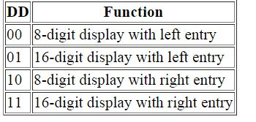
Keyboard Interface of 8279
First three bits given below select one of 8 control registers (Opcode).
000DDMMM
Mode set: Opcode 000.
DD sets displays mode.
MMM sets keyboard mode.
DD field selects either:
8- or 16-digit display
Whether new data are entered to the rightmost or leftmost display position.

Slide 11
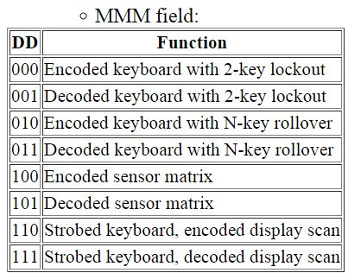
Keyboard Interface of 8279
Encoded: Sl outputs are active-high, follow binary bit pattern 0-7 or 0-15.
Decoded: SL outputs are active-low (only one low at any time).
Pattern output: 1110, 1101, 1011, 0111.
Strobed: An active high pulse on the CN/ST input pin strobes data from the RL pins into an internal FIFO for reading by micro later.
2-key lockout/N-key rollover: Prevents 2 keys from being recognized if pressed simultaneously/Accepts all keys pressed from 1st to last.

Slide 12
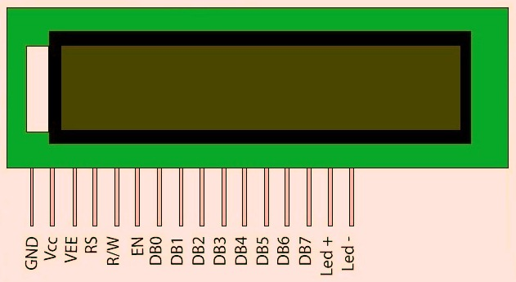
16x2 LCD

Slide 13
Character lcd working, Pinout and description
LCD stands for liquid crystal display. All the lcd's performs the same functions(display characters numbers special characters ASCII characters etc.).Their programming is also same and they all have same 14 pins (0-13) or 16 pins (0 to 15). ALL LCDs have Eight(8) Data pins
VCC (Apply 5v here)
GND (Ground this pin)
RS (Register select)
RW (read - write)
EN (Enable)
V0 \VEE (Set LCD contrast)

Slide 14
8-Data pins carries 8-bit data or command from an external unit such as microcontroller. V0 (Set Lcd contrast) Set lcd contrast here. Best way is to use variable resistor such as potentiometer. Output of the potentiometer is connected to this pin. Rotate the potentiometer knob forward and backward to adjust the lcd contrast. RS(Register select) Their are two registers in every lcd. Command Register
Data Register
Command Register When we send commands to lcd these commands go to Command register and are processed their. Commands with their full description are given in the picture below in the Slide: When RS=0 Command Register is Selected. Data Register When we send Data to lcd it goes to data register and is processed their. When RS=1 Data Register is selected. RW(Read - Write) When RW=1 We want to read data from lcd. When RW=0 We want to write to lcd.

Slide 15
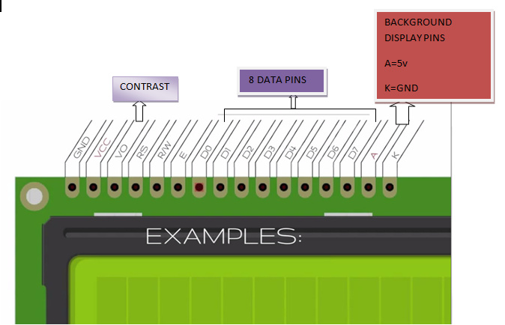
EN(Enable signal) When you select the register(Command and Data) and set RW(read - write) now its time to execute the instruction. By instruction Here it mean that the 8-bit data or 8-bit command present on Data lines of lcd. This requires an extra voltage push to execute the instruction and EN(enable) signal is used for this purpose. Usually we make it en=0 and when we want to execute the instruction we make it high en=1 for some milli seconds. After this we again make it ground en=0.

Slide 16
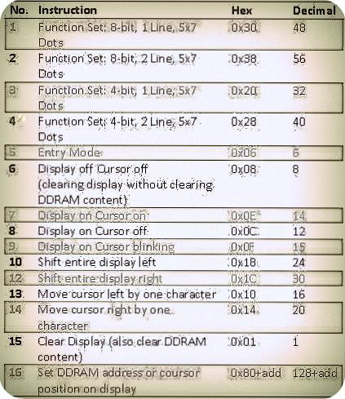
Data which we send to our lcd can be any alphabet(small or big) , digit or ASCII character. NOTE: we can not send an integer,float,long,double type data to lcd because lcd is designed to display a character only. The 8 data pins on lcd carries only ASCII 8-bit code of the character to lcd. How ever we can convert our data in character type array and send one by one our data to lcd.
Standard Lcd Commands with their functions are described with their functionality below.

Slide 17
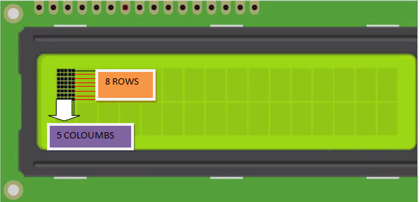
Command 0x30 means we are setting 8-bit mode lcd having 1 line and we are initializing it to be 5x7 character display. Usually the characters are displayed on lcd in 5x8 matrices form. where 5 is total number of coulombs and is number of rows. Thus the above 0x30 command initializes the lcd to display character in 5 coulombs and 7 rows the last row we usually leave for our cursor to move or blink etc.
The Character is displayed on lcd screen in 5x8 or 5x7 matrix. Where 5 represents number of coulombs and 7,8 represent number of rows. Maximum size of the matrix is 5x8. You can not display character greater then 5x8 dimension matrix. To display character greater than this dimension you have to switch to graphical lcds.

Slide 18
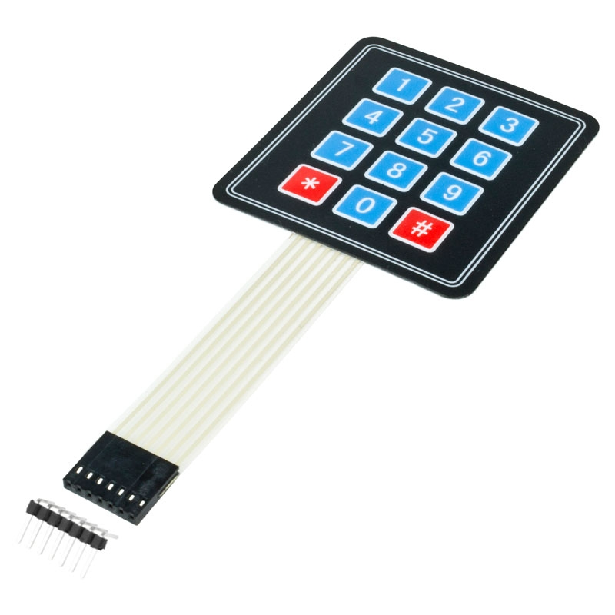
4x3 Keypad

Slide 19
Procedure(Identifying the keypad pins)
Connect your Ohm meter leads to pins 1 and 2.
Press all the buttons until the meter indicates a closure.
Write down the pin numbers next to the column and row for the key you just found. Example: Your meter is connected to pins 1 and 5. When you pressed the number 7 your meter reacted. Write 1 under COL0 and 5 next to ROW2.
If the meter didn't react then move the meter lead from pin 2 to pin 3 and repeat steps 2 and 3 above.
Now, keep moving the lead to the next pin and repeat steps 2 and 3 for each pin.
Once you have reached the end move the first meter lead from pin 1 to pin 2 and repeat steps 2 and 3 while connecting the second meter lead to pins 3 through the highest pin.
Once you have completely identified all the pins on the diagram then you can safely ignore any unused keypad pins. You are now ready to wire the keypad to your Arduino.

Slide 20
NOTE
The library is non-blocking which means you can press and hold the key all day long and your Arduino will continue processing the rest of your code.
Consider, though, when you are writing your code that every delay() you use will take processing time away from the keypad. Something as short as delay(250) can make the keypad seem very unresponsive. And the same thing will happen if you sprinkle a bunch of delay(10)'s all through your code.
The function getKey() (Reports the ASCII value of a key being pressed or released on an attached USB keyboard.)returns a key value as soon as you press the key but it does not repeat automatically. Also, when you release the key you can track the key RELEASED event if you are using the eventListener feature of the library.

Slide 21
Library Working Example:
#include <Keypad.h>
const byte ROWS = 4; // Four rows
const byte COLS = 3; // Three columns
// Define the Keymap
char keys[ROWS][COLS] = { {'1','2','3'}, {'4','5','6'}, {'7','8','9'}, {'#','0','*'} };
// Connect keypad ROW0, ROW1, ROW2 and ROW3 to these Arduino pins.
byte rowPins[ROWS] = { 9, 8, 7, 6 };
// Connect keypad COL0, COL1 and COL2 to these Arduino pins.
byte colPins[COLS] = { 12, 11, 10 };
// Create the Keypad
Keypad kpd = Keypad( makeKeymap(keys), rowPins, colPins, ROWS, COLS );
#define ledpin 13
void setup() {
pinMode(led pin, OUTPUT);
digitalWrite(led pin, HIGH);
Serial.begin(9600); }
void loop()
{ char key = kpd.getKey();
if(key) // Check for a valid key.
{ switch (key)
{ case '*': digitalWrite(led pin, LOW); break;
case '#': digitalWrite(led pin, HIGH); break;
default: Serial.println(key); } } }

Slide 22
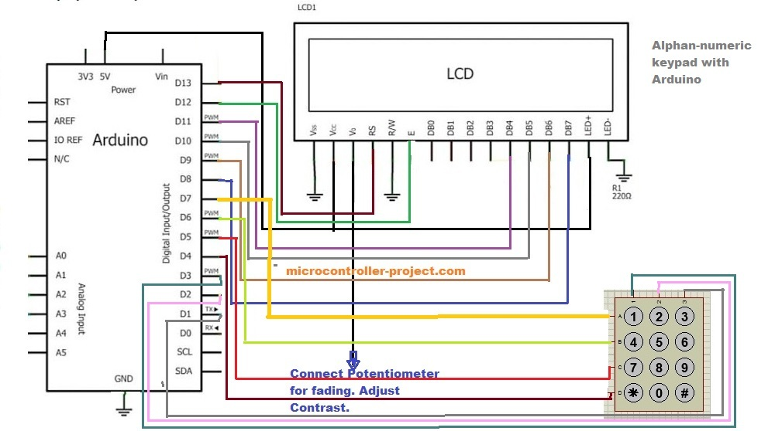
Interfacing Keypad and LCD in Aurdino

Slide 23
4x3 keypad is programmed to perform alphanumeric keypad functionality. Characters and numbers associated Keypad will be displayed on 16x2 lcd, if any button is pressed.
Procedure Followed:
Make rows output and columns input. Now ground one row and others should be high. Press any button of the keypad then check the status of the columns if any column is low do code stuff(Here I mean Code Accordingly). If column is low do stuff like print some text or message on 16x2 lcd, run interrupt service routine etc. The above method is applied on simple 4x3 keypad. To design an alphanumeric keypad what we do is checks the column status. If it is grounded do some stuff and remain in the if-condition and check the same button or coulomb second time if it is grounded do stuff and remain in second if-condition and so on. If 4 alphabets are associated with your button then you should start from first and go until 4th condition is meet. ( Here I have Used Idea of If Conditionals but we can Use any other Method)
16x2 lcd is interfaced in 4-bit mode with arduino uno. RS(register select) pin of 16x2 lcd is connected to Pin#13 of Arduino. E(enable) pin of lcd is connected to Pin#12 of Arduino. D4, D5, D6 & D7 data pins of lcd are connected to pin 11, 10, 9 & 8 of Arduino. But when we want to save the pins of our microcontroller we use lcd in 4-bit mode. In this mode 8-bit character is divided in to two nibbles (1 nibble=4-bit) and data is send in nibbles.

Slide 24
In the code I first imported the Liquid Crystal library. This library contains all the necessary functions to initialize the 16x2 lcd. It also contains the functions to send commands and data to lcd. Then I defined my rows and coulombs for keypad. Arduino pins 7 ,6 ,5 & 4 are dedicated for my keypad rows and Arduino pins 3, 2 & 1 are dedicated for keypad coulombs. In setup function i initialized the lcd in 4-bit mode and 5x7 character display, made rows output and coulombs input. In the loop function i first set the lcd cursor on first row and first coulomb of lcd. Then alphkeypad() function is called. This function performs the function of alphanumeric keypad. The code is placed in while loop. Program control will remain in this while loop until the a='c'.

Slide 25
6x2 lcd in 4-bit mode with Arduino
First import the <liquidCrystal.h> library This library is designed to provide necessary functions to be used with lcd. Then the line LiquidCrystal lcd(12,11,5,4,3,2); is initializing the lcd in 4-bit mode. Arduino has less pins than other simple micro controllers so we use lcd with Arduino in 4-bit mode.
* LCD RS pin to digital pin 12 * LCD Enable pin to digital pin 11 * LCD D4 pin to digital pin 5 * LCD D5 pin to digital pin 4 * LCD D6 pin to digital pin 3 * LCD D7 pin to digital pin 2

Slide 26
The liquidcrystal library do as it is coded in such a way that it automatically assign pins in the above format. Note that always assign the pins in descending order like 12,11,5,4,3,2. If you not assign it in descending order than your lcd wont work. In the statement the starting keyword LiquidCrystal is the library keyword than in lcd(12,11,5,4,3,2) lcd is the name which we are going to use for our lcd operations you can also change it according to your wish. In setup loop my first statement is lcd.begin(16 ,2). The statement tells the Arduino Atmag micro controller that we are using 16x2 lcd. Rest of the code is very easy I hope you can understand them. The LiquidCrystal library can perform many functions here is detail of each function. lcd.clear() ->This clears the screen (and sets the cursor to theupper left hand corner). lcd.print() ->Prints the text.
lcd.setCursor(column, row) ->It takes two arguments first is column and second is row to which we want to set our cursor.
lcd.noCursor() ->Shows no cursor on the screen.
lcd.cursor() ->Brings back the cursor.
lcd.noDispla() ->Nothing will display on the lcd.
lcd.display() ->Trun on the dispaly.
lcd.blink() ->Cursor will blink on the screen.
lcd.noBlink() ->Cursor will not blink on the screen.

Slide 27
Code
REFER DOCUMENT “ HELLO KEYPAD “

Slide 28


